Slide 1
Shira Clamp for Microvascular Surgery
Global Entrepreneurship and Innovation
India 2019

Slide 2
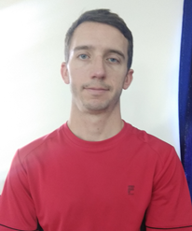




Patrick Phelon, Engineering Management Graduate student at UMass Amherst,USA
Ruike Zhang, Human Resources Management Graduate student at Nanjing University, China
Hannah Bagley, Junior Biomedical Engineering student at UMass Lowell, USA.
Vaishakh Kuppast, Electronics and Communication Engineering UG in KLE Technological University, India
Manoj Madnur, Mechanical Engineering UG in KLE Technological University, India

Slide 3
Overview
Nearly 1,00,000 amputations are caused every year in India due to lack of access to surgeons skilled in microvascular surgery
The current solution is Bulldog and other clamps, which stop the flow of blood but do not hold the blood vessel open
Our proposition: The Shira Clamp
Surgical instrument that makes the complex surgical process of coupling small blood vessels easier and faster
Not only clamps the vessels to stop blood flow, but keeps their ends open and visible to the surgeon
Lessens the learning curve for training and operation time of surgeons

Slide 4

Overview
Potential Outcomes:
Reduce necessary training for surgeons
Reduce environmental impact
Reduce number of amputations due to errors in microvascular reconstruction
Risks:
Recruiting necessary funding to continue venture until it becomes profitable
Gaining brand recognition and a significant market presence
Surgeons accepting new technology

Slide 5
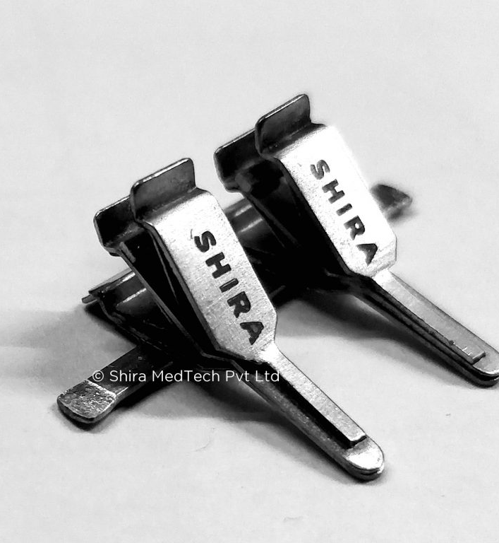
The Problem
Repairing blood vessels in patients as part of surgery is a very difficult and complicated task requiring expertise, skill, and training. Because this procedure is so difficult and there are not enough surgeons with the specialty to perform it, injuries with blood vessel damage often results in gangrene, and therefore unnecessary amputation.

Slide 6
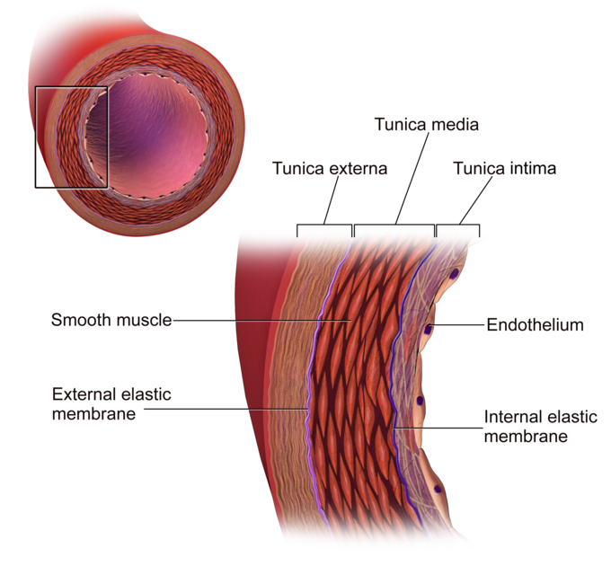
Background and Definitions
Amputation: Severing of a limb/body part
Gangrene: Condition that is caused by tissue death
Anastomosis: A surgical connection between blood vessels
Lumen: The innermost, hollow region of the blood vessel

Slide 7

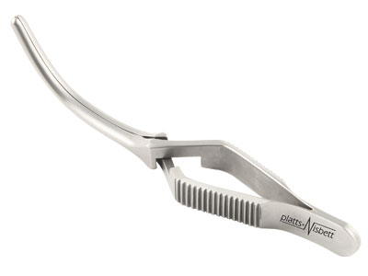
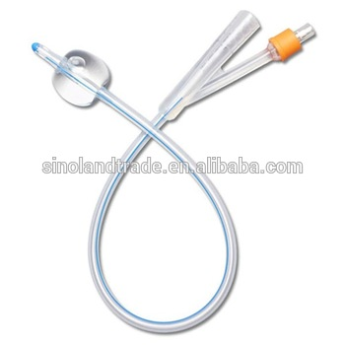
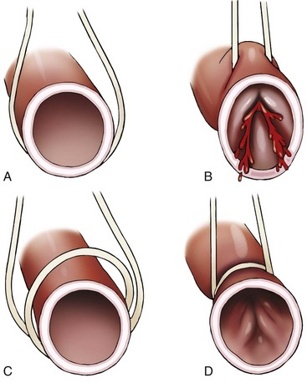
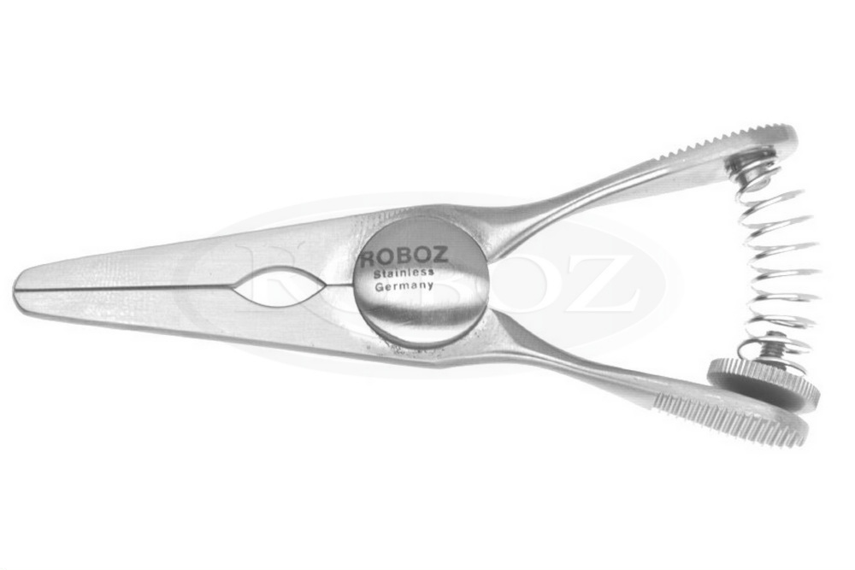
The Problem
Pain:
Surgeons cannot find blood vessels easily during surgery and keep them together to perform anastomosis
Patients suffer from unnecessary amputations because of this
Current Solutions:
Various types of clamps

Slide 8
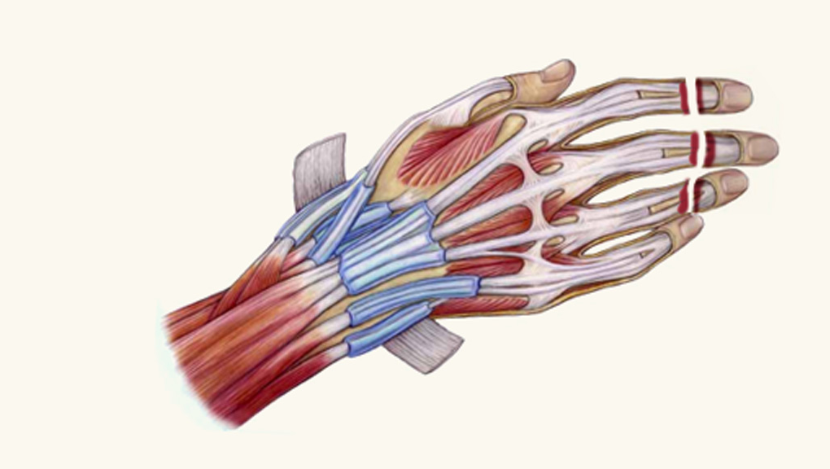
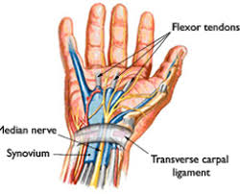
The Problem
Why aren't customers satisfied?
Time consuming for surgeons
Tissue Damage to blood vessels
Ends of blood vessels can slip easily due to improper positioning of blood vessels
End result can lead to amputation
Will the problem get better?
Amputations will continue to happen until a viable solution is found

Slide 9
The Problem
What do potential customers think?
Dr. Srishail Chiniwalar of Super Specialty Hospital, Hubli said that he belived the ability of the clamp to position blood vessels close together would be beneficial in aiding to the ease of surgery
He even said he would help market our product!
Dr. Wang Yun of Changzhou First People's Hospital believed this would provide ease of use to surgeons
However, he believed the price was too high

Slide 10

A clamp used for microvascular surgery
Allow surgeons without extensive training or specialized skills to repair damaged or severed blood vessels
Our unique design is:
Durable
Reusable (able to be sanitized)
Adjustable to accommodate various different surgeries
Digital, brachial, and femoral reconstructive surgeries

Slide 11
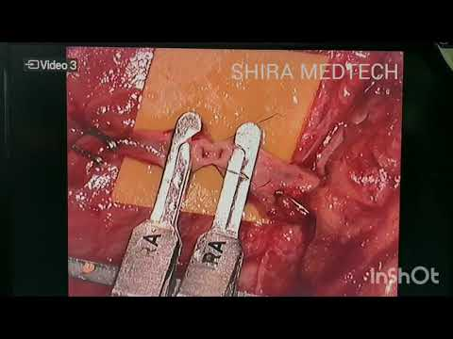
Shira Clamp
https://www.youtube.com/watch?v=Hnz-WdXcwIY

Slide 12
Opportunity and Target Market
Target Markets:
Hospitals medical supplies procurement departments in India
Vascular/General Surgeons in India
The Surgeons can be driven by developing awareness among healthcare providers. The awareness programs which aims out to vascular surgeons across the country, advising them on a range of topics related to vascular disease and its incidence, screening and treatment and provide them with videos, articles, research guides..
In 2014, 20 million clamps were consumed in China, and the output increased 46% year on year; in 2015，31 million clamp products were consumed, up 54% year on year; 43 million clamp products were consumed in 2016, up 43% year on year.
Said Surgeons are going to be the drivers for buying this product. If they don’t want it, they won’t recommend their hospitals to order it, if they want to fix the pain of the amputees, they need to show the surgeons that there is a pain and that their product can help to alleviate that pain

Slide 13
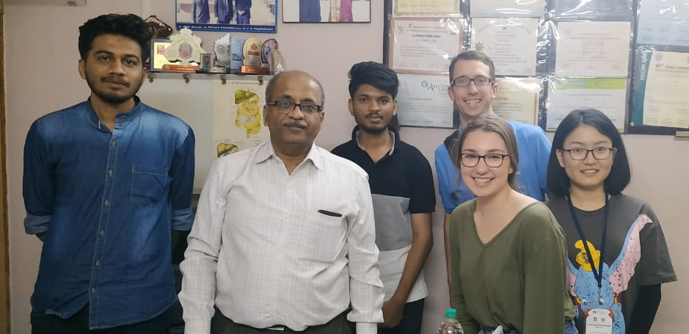
Research
Interviews Conducted
Individual | Occupation | Location
Dr. K.G. Byakodi | Surgeon, Specialist | Sushruta Hospital, Hubli, India
Dr. Shirshail Chiniwalar | Surgical Gastroenterologist | Super Speciality Hospital, Hubli, India
Dr. Wang Yun | Surgeon | Chang Zhou First People’s Hospital, Chang Zhou, China
Dr. Han Xu | Head of Surgery | Nanjing Drum Tower Hospital, Nanjing, China
-Interviews were conducted in person and using online chat
Secondary Research
Secondary research was performed from various mediums that included sources from India, China, and the United States of America

Slide 14
Primary Research (India)
Dr. K.G. Byakodi (22 years of experience in Hubli, Saudi Arabia, and Mumbai)
Trained doctors typically perform microvascular surgery using suturing
Some of the doctors conduct surgery of 1-2 mm of vessels under microscope during digit implementation, or repairing blood vessels in the fingers/toes
Patients can develop gangrene, which causes amputation of whole limb or amputated organ
It usually takes 30-45 minutes for performing vascular Surgery
If we don't have these clamps then we use rubber forceps to operate these veins
~5% of anastomosis lead to gangrene and subsequently amputation

Slide 15
Primary Research (China)
Dr. Wang Yun (5 years of experience as a surgeon in China)
The biggest difficulty in Microvascular Surgery is finding the location of the ruptured vessel.
Used during any vascular repair procedure. It is necessary to use clamp to help us complete the operation smoothly, such as better vascular fixation, and improve the success of the operation.
Repair time varies from 10 minutes to half an hour after finding the bleeding point. And some large operations take 2-4 hours.
If the blood vessel is not repaired in time, it will bleed quickly and cause amputation and sometimes even death
The advantages are that it exposes the field of vision, improves the efficiency of vascular repair, and reduces the amputation rate and mortality rate.

Slide 16
Secondary Research
The leading cause of amputation in India is due to Trauma (1)
Amputation in 28% of patients is due to failed revascularization. (2)
Extremity vascular trauma can be seen in civilian population according to a seven-year review from North India (3)
Amputation caused in 6% of patients after an initial surgical repair is mainly due to inadequate functional recovery (3)
Time is an issue, so access to skilled surgeons is critical (4)
Therefore a tool that allows a general surgeon to perform the repair work that would normally require a specialist would most likely decrease time to surgery (4)

Slide 17
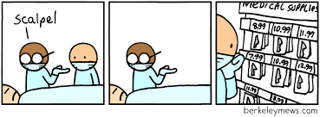

Technology
Patented thumb-nail sized surgical-assist device
Holds the vessel-ends open and provides a clear, visual access of the suture site to the surgeon
Dual-clamp technology to both restrict blood flow in the blood vessel, and also position the ends of the blood vessel to remain open and adjacent
Works like a "Binder Clip" in how it opens and closes when the surgeon is applying it to the blood vessel

Slide 18
Competition
Market forces are moderate so there exists some profit potential
Need to establish a place and following in the market in order to capture some of the profit potential
Porter's Five Force Analysis
Force | Strength
Threat of New Entry | Moderate
Power of Suppliers | Low
Power of Buyers | Strong
Threat of Substitutes | Low
Rivalry | Moderate
Role of Compliments | Low
Competitors
Bulldog Clamps
Doubly applied vessel loop
Glover Bulldog Clamp
Balloon Catheter
Forceps Clamps
Substitutes
Expert training
and experience

Slide 19
Porter’s Five Force Analysis
Threat of New Entry (moderate)
Currently have a patent on the product
Other competitors have a big market share
Power of Suppliers (low)
Shira could fairly easily change suppliers
Power of Buyers (strong/weak)
Strong for medical supply companies
Weak for individual hospitals
Threat of Substitutes (low)
Substitute is lots of time and training to become an expert using current means
Rivalry (moderate)
Many firms with similar products
Role of Compliments (low)
This product does not require compliments

Slide 20
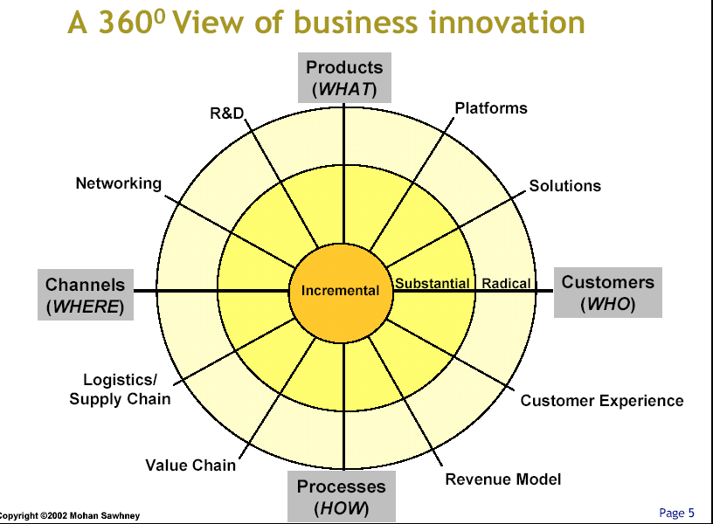
360⁰ Competitive Radar Chart

Slide 21
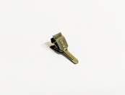

SWOT Analysis
Strengths Unique product with active patent | Weaknesses Lack of market position and brand recognition No performance data for proof of value proposition High price----8,900-14,900 rupees
Opportunities Large potential domestic market National Policy Support India currently has a healthy environment for innovation in the medical industry India's economic growth rate is relatively high and its economy has achieved rapid development | Threats Increase in technology used in surgery Strong alternatives bring enormous competitive pressure 1. Competitors 2. Substitute Difficulties in Cross-cultural Management

Slide 22
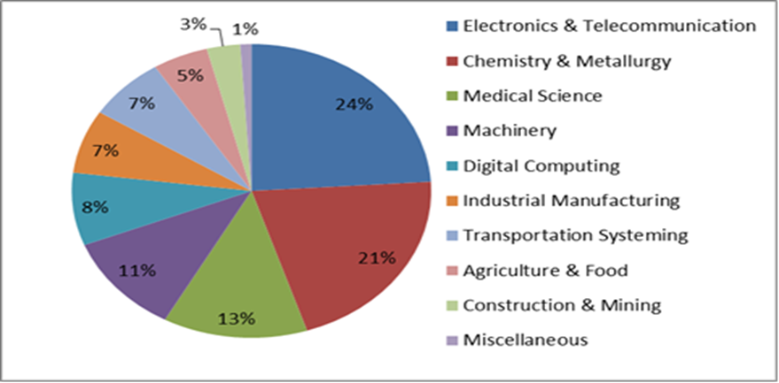
Opportunities - India currently has a healthy environment for innovation in the medical industry -India's medical industry innovation accounted for 13% of India's innovation output between 2011 and 2015
SWOT Analysis

Slide 23
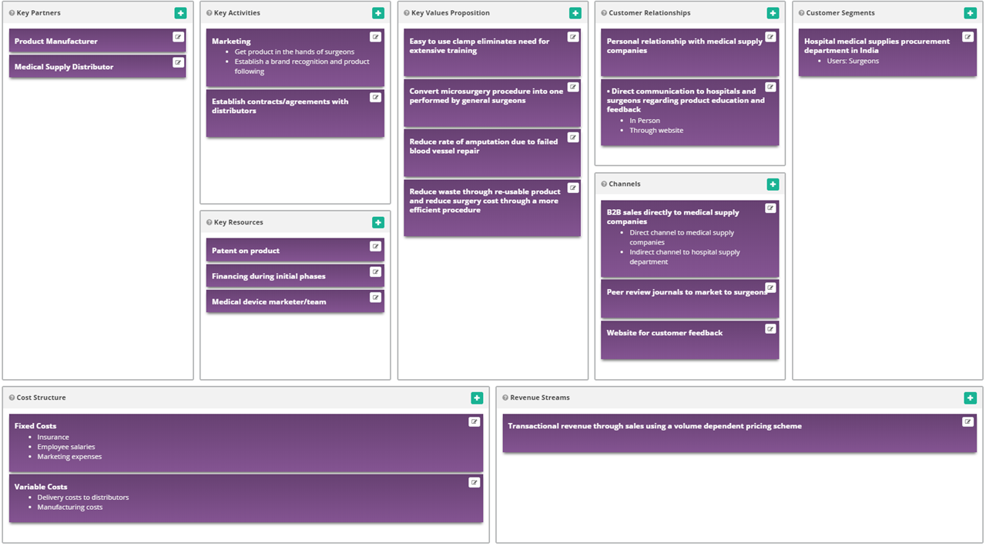
Business Model Canvas

Slide 24
Conclusions
There is a pain that can be relieved
Profit potential exists in the industry
Shira has the potential to create a desirable value proposition
Recommendations
Distribute through medical supply company rather than direct sales through website
Target marketing both to surgeons and to hospital supply procurement department by appealing to business benefits
Reusability, surgery time reduction, decrease number of post-op complications
Incorporate an easy to use feedback/customer portal for surgeons to communicate back to company
Establish a brand recognition by getting the product in the hands of surgeons
Potential future product improvement would be to reduce trauma induced by clamping mechanism

Slide 25
References
https://www.sciencedirect.com/science/article/pii/S1013702512000474
https://ac.els-cdn.com/S074152141500155X/1-s2.0-S074152141500155X-main.pdf?_tid=63a4ae1d-e8ff-47a6-886e-01c2e8a7c784&acdnat=1546850551_7cdb49b3ccc267953ad93ca349d14b68
https://www.sciencedirect.com/science/article/pii/S0020138304002475
https://www.ncbi.nlm.nih.gov/pmc/articles/PMC4727477/
https://shiramedtech.com/

